Slide 1

Exploratory Data Analysis
G2M Case Study
Nov 2022
John Wu

Slide 2

Agenda
Executive Summary
Problem Statement
Approach
EDA
EDA Summary
Recommendations

Slide 3
Executive Summary & Problem Statement
XYZ is a private firm in US. Due to remarkable growth in the Cab Industry in last few years and multiple key players in the market, it is planning for an investment in Cab industry and as per their Go-to-Market(G2M) strategy they want to understand the market before taking final decision.
Objective : Provide actionable insights to help XYZ firm in identifying the right company for making investment.

Slide 4
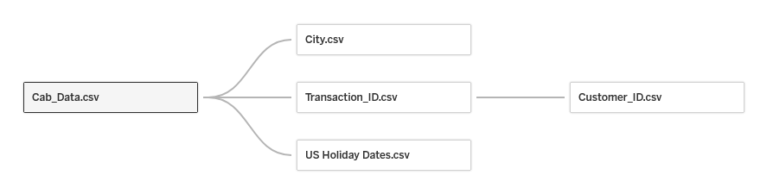
Approach
Time frame: 31/01/2016 to 31/12/2018
848681 Observations, 14 Features
Assumptions: Mismatched user count data that does not belong to either company are inactive customers during the timeframe.
Preprocessing was done to find missing or null data as well as outliers.
Making Cab_Data the master dataset with the others will be the main analysis.
Tableau, matplotlib, and seaborn were used to generate charts and graphs.
Linear regression and Tableau’s forecasting were used to derive insight into future data.

Slide 5
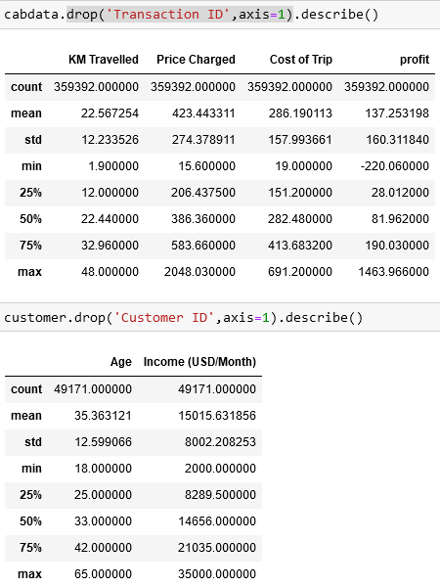


ETA: Important Stats of Cab Data and Customers
Summary Stats of Cab Data
Customers per company
Gender of Customers
Summary Stats of Customer Data

Slide 6
EDA: Profit between both companies
Although Yellow Cab has most of the profit, it is recommended that we continue to look at the data in to derive deeper insights
The number of unique customers, however, is similar between both companies.

Slide 7
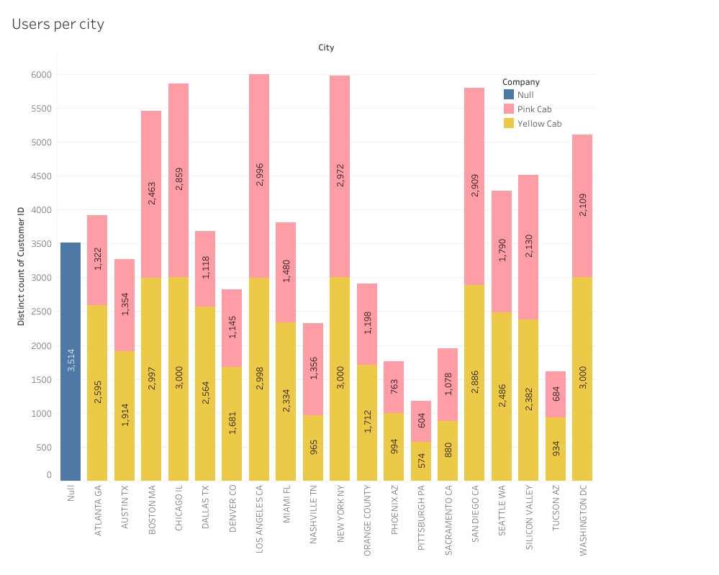
EDA: Users per city
Although Pink Cab has less profit, perhaps its value can be seen in serving underserved cities. However, we see that even in cities with small populations, the number of users between both companies is similar.

Slide 8
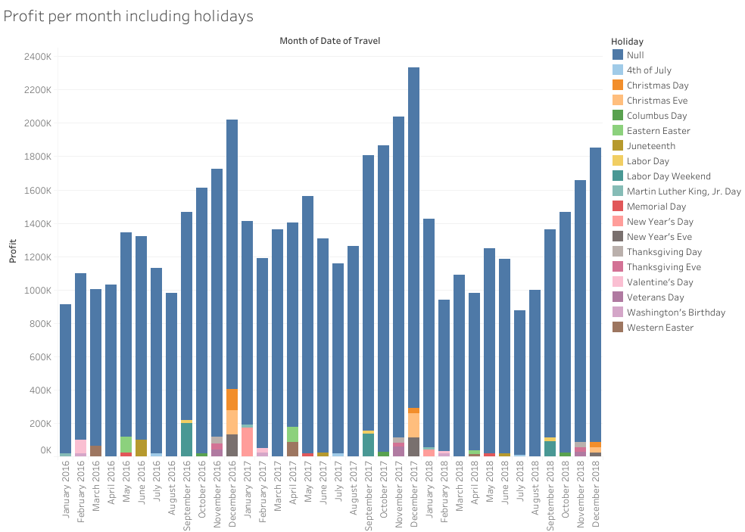
EDA: Holiday Profits
Here “Null” shows profit for days that are not holidays.
Peaks and dips in profits cannot be explained by holiday sales alone as they are only a small portion of profits.

Slide 9
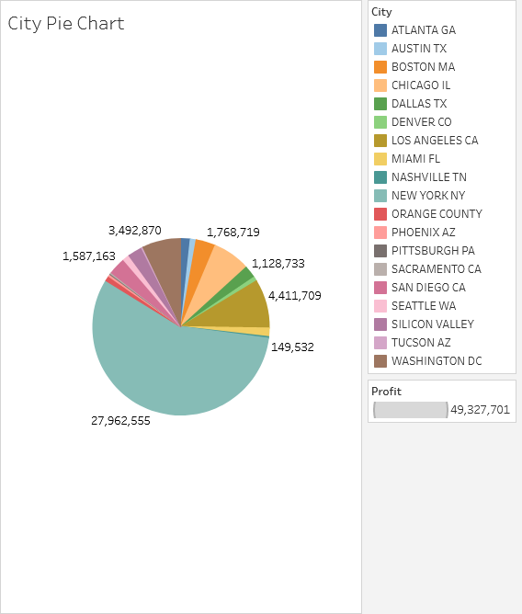
EDA: NYC vs other cities
Since New York City has more than half of the total profit, insights should be derived with NYC separately.
Additionally, NY has a historical cab culture, Northeastern weather with 4 distinct seasons, and is the largest American city. This is another reason why New York should be looked at distinctly.

Slide 10
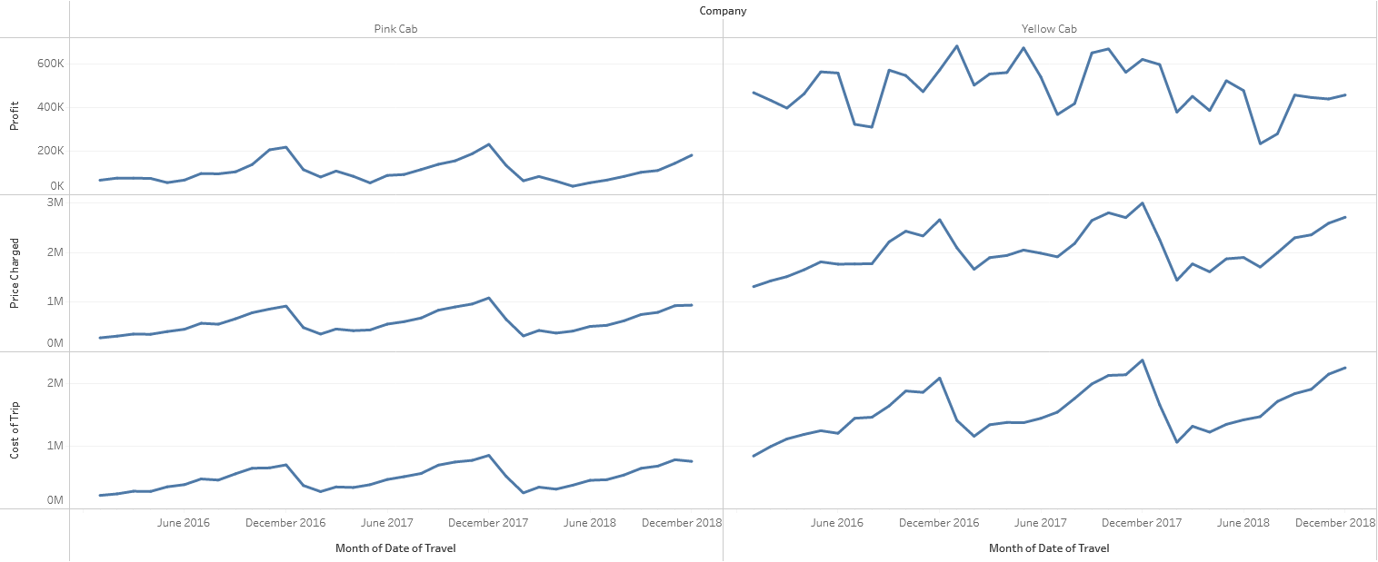
EDA: Profit seasonality between both companies
Seasonal peaks appear between both companies. However, Yellow Cab has less predictable profits that do not correspond to December spikes.

Slide 11
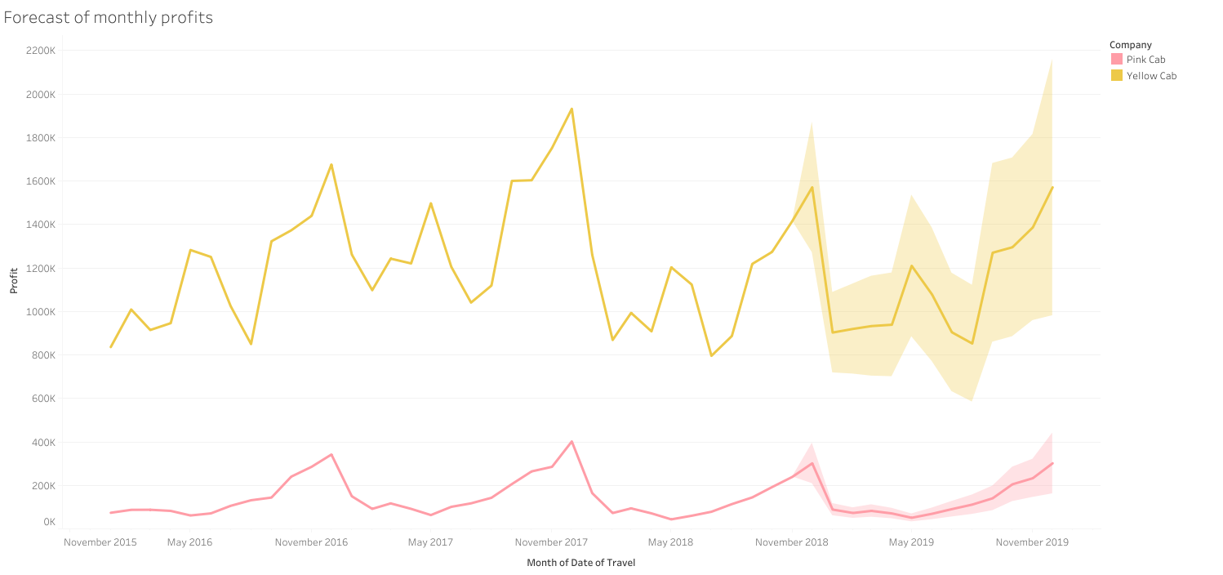
EDA: Forecast of monthly profits
This is the profit forecast for both companies with 95% confidence intervals. Although the profits for Yellow Cab are higher, Pink Cab has less volatility.

Slide 12
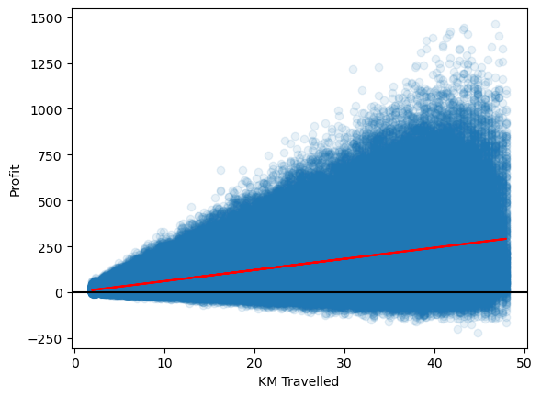
EDA: Distance vs Profit
The red line is a linear regression of distance vs profit, and the black line splits the graph between gains and losses.
Profit increases with distance traveled. As obvious as this is, there are also many outliers in profit with greater distance. Additionally, losses in profit also increase with distance but not as much as the gain.

Slide 13
EDA Summary & Recommendations
Data that is not given:
Time of day data is important, as variable cab fare for busier times may ensure better profit.
Other data like change in user base and change in population over time should be included.
For the best outcome, we should analyze what makes Pink Cab so stable with its user base (advertising, loyalty rewards, etc.) and seasonal usage, along with what makes Yellow Cab so profitable.
Based on EDA:
Yellow Cab is more profitable based on profit per user and so should be invested in more.
New York City is the most profitable city.

Slide 14
Thank You

